Slide 1
EE0005 Mini Project
Fraudulent Job Postings
Philip, Keng Soon, Hansel, Lee Hua
Contribution parts are listed at the end

Slide 2
Why this dataset?
Fake job postings do a lot of harm:
Waste time
Personal information lost
Our objectives:
Identify fake job postings by sentiment analysis.
Which model is the best? → metric scores, memory and speed
Identify countries which are associated with fraud postings.
Find associated features with a fraudulent and non-fraudulent posting.

Slide 3
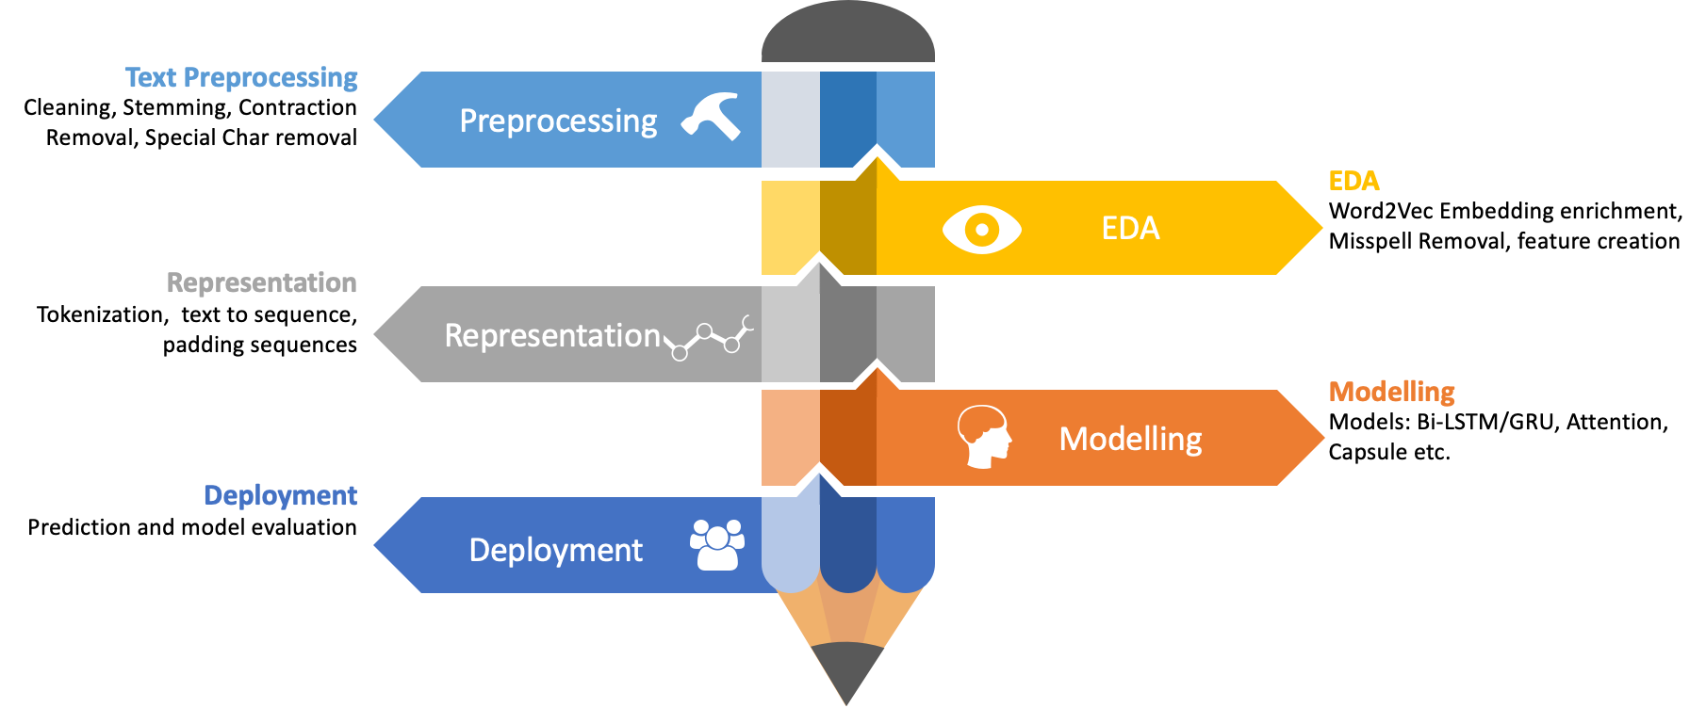
NLP Pipeline

Slide 4
Exploratory Data Analysis
We will analyse the following with supporting visualization:
Distributions
Correlation
Associated words with real / fraudulent posts
Proportion of fraudulence from top 10 countries

Slide 5
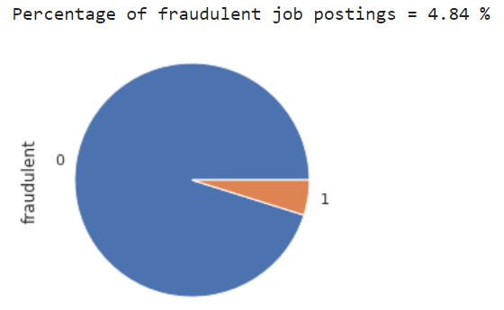
Overview of dataset
Notes:
This is the overview, we can see that about 4.84% job postings are fraudulent

Slide 6
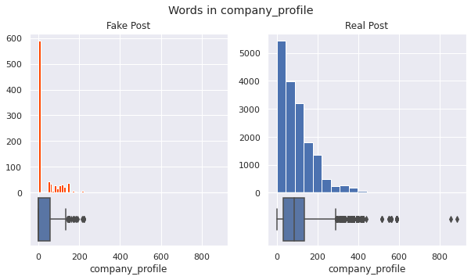
Distributions of word count
Notes:
Now I will show the distributions of word count. The text features that we have are company_profile, description, requirements and benefits. We found that only the distribution for company_profile is different.

Slide 7
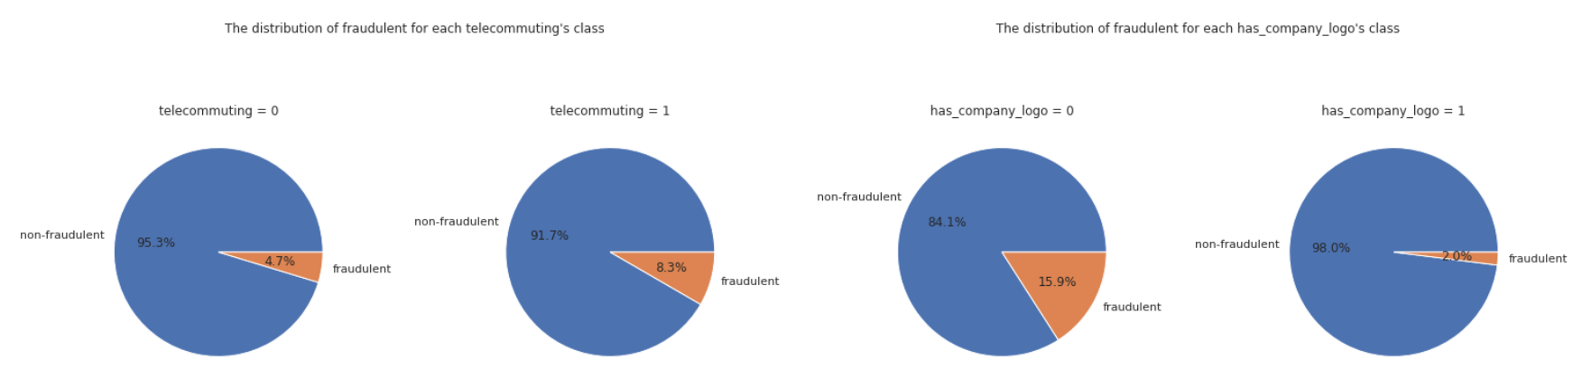
Distributions of binary features
Notes:
We have also done the distributions of binary features. For telecommuting, we observed that there is an increase in fraudulence for jobs with telecommuting

Slide 8
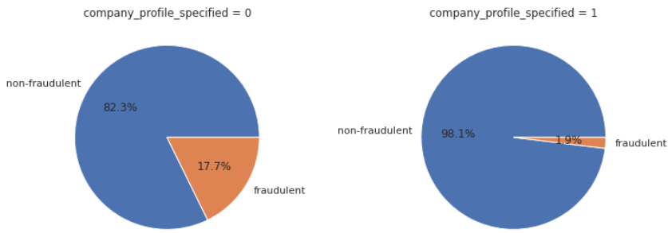
Hypothesis
Distributions of binary features (2)
has_company_logo
company_profile_specified
Important features in fraud job postings
Notes:
From the distributions of binary features, we found that has_company_logo and company_specified are important features in fraudulence.

Slide 9
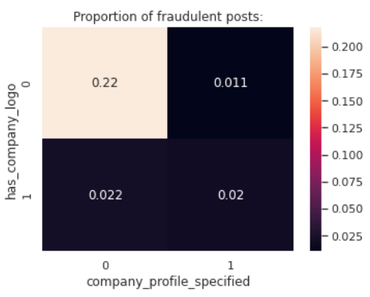
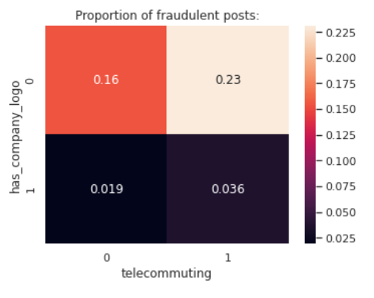
Correlation of has_company_logo (1)
Notes:
Here we have the correlation between has_company logo and 2 other variables, company_profile and telecommuting
We can see the correlation is on the lower end (close to 0)

Slide 10
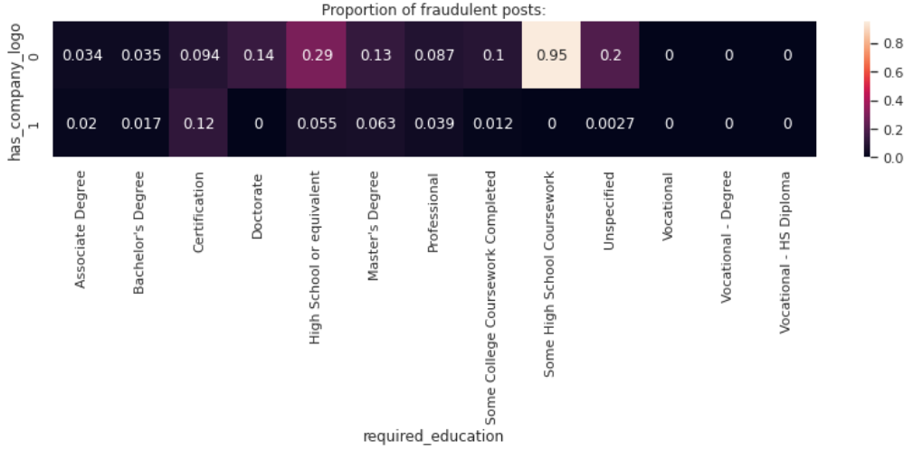
Correlation of has_company_logo (2)
Notes:
This is the correlation between has_company logo and required_education. The correlation are generally low between company logo and most education background except for a few.

Slide 11
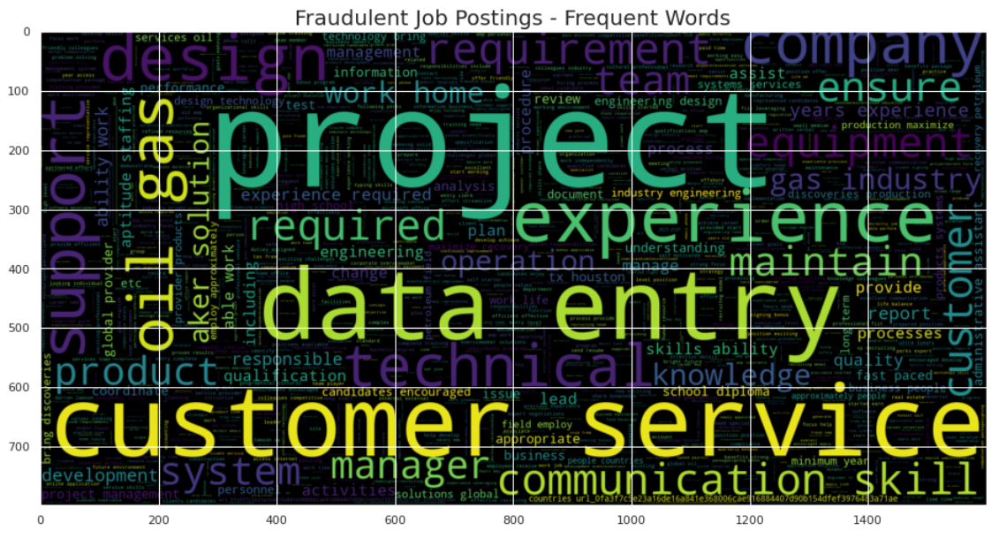
Associated words with fraudulent posts
Notes:
Here we have the word cloud which shows words that frequently appear in fraudulent posts

Slide 12
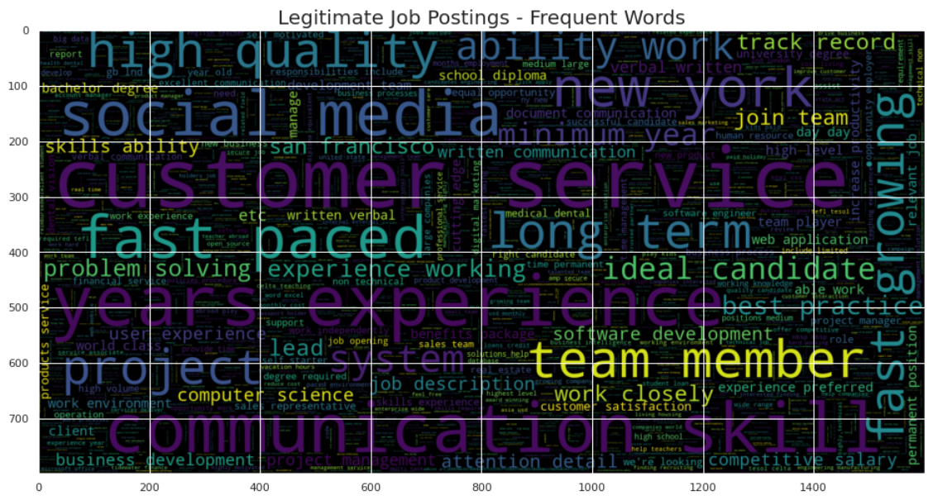
Associated words with real posts
Notes:
And these are the words that appear frequently in real posts

Slide 13
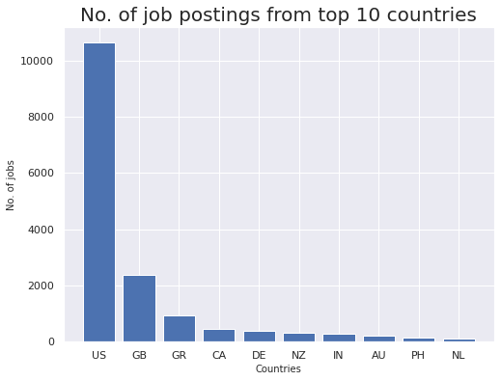
Source of fraudulent job postings
Notes:
Here is the overview of number of job postings from the top 10 countries
We should note that high number of job postings does not mean there will be higher fraudulence which we will see in the next slide

Slide 14
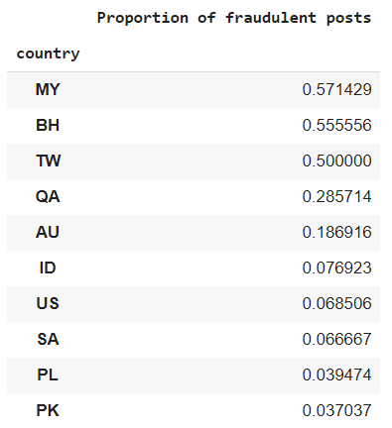
Proportion of fraudulent job postings
Feature weights from model (in descending order):
Difference in order due to random sampling of train-test data!
✓ Identify countries which are associated with fraud postings
Notes:
To answer one of our objectives, here is the top 10 countries with significant proportion of fraudulence
The difference in the order could be due to the random sampling of train-test data
But generally the countries shown are in the top 10 source of fraudulent job postings
We can see that although US has highest number of job postings, it has a lower proportion of fraudulence compared to other countries
Now i will pass my time to hansel

Slide 15
Metrics & Oversampling

Slide 16
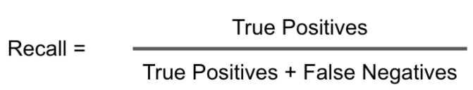
Dummy Classifier has good accuracy!
dummy_clf = DummyClassifier(strategy="most_frequent")
Accuracy: 0.9559 (from predicting all ‘0’)
Our dataset is imbalanced
Classification accuracy is not a good performance measure
False negatives do more harm, so maximising recall is important

Slide 17

F2 Score & ROC AUC Score
F2 Score can emphasize the recall, minimizing false negatives
ROC (Receiver Operating Characteristic) Curve tells us about how good the model can distinguish between two things
* Fake postings do more harm then missing out on the real postings!
Notes:
In our case, we chose to utilize the ROC AUC Score and F2 Score to determine the accuracy of the predictive model.
#ROC Curves summarises the trade-off between the two things for a predictive model using different probability thresholds, however it may not be very accurate for imbalanced datasets, which our dataset was.
F2 Score calculates the accuracy of the model through a weighted harmonic mean of Recall and a beta coefficient.
Higher F2 score indicates a lower false negative prediction.

Slide 18
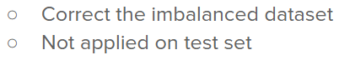
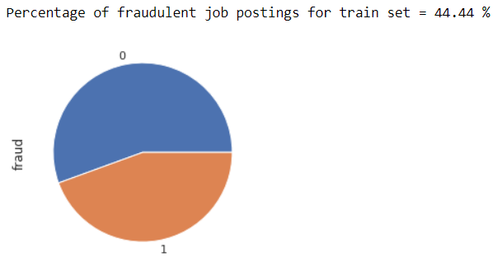
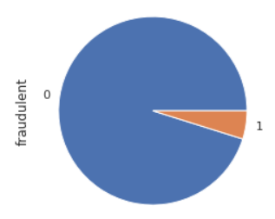
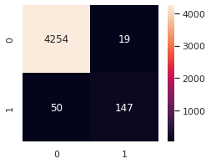
Oversampling
BEFORE
ROC AUC : 0.8709
F2 Score : 0.7704
Notes:
Important thing to note is oversampling not done on test set to reflect the real life proportions.

Slide 19




SMOTE
SVMSMOTE
ROC AUC: 0.9119
F2 Score:
0.8152
ROC AUC: 0.9143
F2 Score:
0.8185
We choose this as SVMSMOTE is very slow, and decent F2 score.
BorderlineSMOTE
ADASYN
ROC AUC: 0.9025
F2 Score:
0.8042
ROC AUC: 0.9107
F2 Score:
0.8072
Notes:
Reference: https://machinelearningmastery.com/smote-oversampling-for-imbalanced-classification/
We don't use undersampling as it decreases our training data, 18k not a lot, bring down the metric scores in general
SVMSMOTE takes too long so we settle for SMOTE since there is only an incremental difference
SVMSMOTE is an even more specialised from of BorderlineSMOTE, using the SVM algorithm to compute.

Slide 20
Pre-processing

Slide 21
Feature extraction
1. telecommuting :
0 -> telecomuting_no
1 -> telecomuting_yes
2. required experience:
Internship -> required_experience_internship
3. Fill blank with ‘_’
required_education_ bachelor’s degree -> required_education_bachalor’s_degree
4. fillna
5. lowercase:
country_US -> country_us

Slide 22
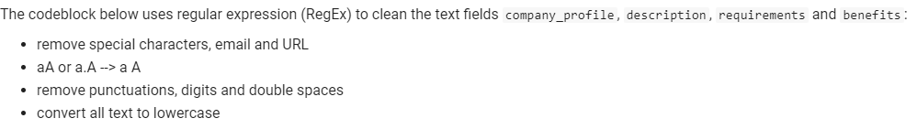
Text Cleaning
Before | After
ProgramAssisting 32 in day-to-day | program assisting in day to day
WEBSITE is #URL_b0bc289 | website is

Slide 23
Remove Stopwords
Stopwords are common words like "I, the, an" which needs to be removed as they will be counted in during the vocabulary frequency.
Before | After
this position is high paying | position high paying
you will be paid weekly via direct | paid weekly direct

Slide 24
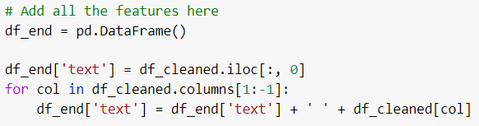
Combine Text Feature
Combine all columns after feature extraction
Sample text:
telecommuting_no country_us state_ny city_new york company_logo_yes company_profile_yes has_questions_no employment_type_other required_experience_internship function_marketing marketing intern department_marketing food weve created groundbreaking award winning cooking site support connect celebrate home cooks

Slide 25
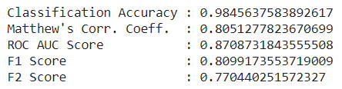
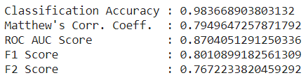
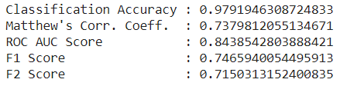
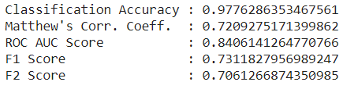
Lemmatization
Change a word to its base form Eg. hearing → hear ; management → manage
Purpose: To reduce the vocabulary count for similar word meanings
Downside: Takes a long time as you need to map POS tag for each word
* But this reduced our metric scores, so we won’t use it!
Before (All text features combined)
After (All text features + lemmatization)

Slide 26
Modelling - Sentiment Analysis
Identify fake job postings ✓
Random Forest Classifier, Logistic Regression, Bernoulli Naive Bayes, Multinomial Naive Bayes, Support Vector Machine, Simple Neural Network

Slide 27

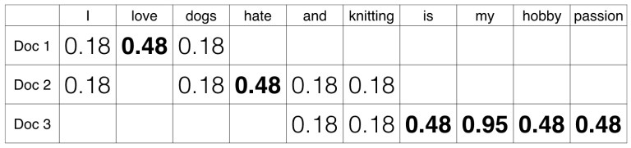
TF-IDF Vectorizer TF-IDF: term frequency–inverse document frequency
Only use a max of 20000 text features used, if all features are used:
Takes more time & lower metric scores
Unigram and bigrams are both used

Slide 28
Modelling
1. Random Forest Classifier
- Grid Search CV

Slide 29

Correct Imbalance Datasets (RandomForestClassifier)
Problem:
Imbalance dataset and RandomForest has a tendency to bias towards majority class.
Oversampling
Does not increase information; however by replication it raises the weight of the minority samples.
Class weighting
Imposts a cost penalty to the minority class misclassification
Assign high weight to the minority class
set class_weight="balanced"
Notes:
TFIDF is used to vectorize the input text data and the input dimension for x_train =(22933, 20000)and y_train=(22933,).
class_weight="balanced" will replicate the smaller class until has as many sample as in the larger one but in an implicit way.

Slide 30
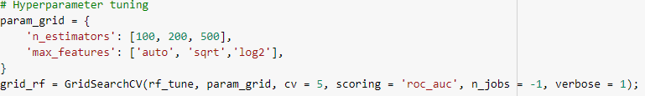
GridSearchCV
GridSearchCV is a library function in sklearn.model_selection package to autonomate the process of performing hyperparameter tuning.
It tries all the combinations of the values passed in the dictionary and evaluates the model for each combination using the Cross-Validation method in order to determine the hyperparameter value set which provides the best ROC AUC score (scoring = 'roc_auc')
5-fold cross validation is applied in this case.
Notes:
CV in GridSearchCV stands for cross validation

Slide 31
Modelling
2. Logistic Regression
3. Bernoulli Naive Bayes
4. Multinomial Naive Bayes
5. Support Vector Machine
- Hyperparameter tuning

Slide 32
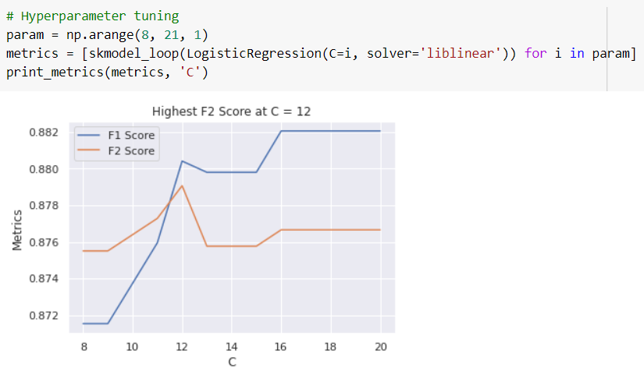
Hyperparameter Tuning
Custom functions are used to tune hyperparameters for each model used
Notes:
F2 is prioritised during hyperparameter tuning

Slide 33
Modelling
6. Simple Neural Network (Keras)
- Custom layers

Slide 34
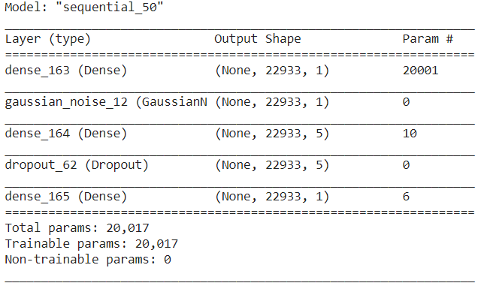
Simple Neural Network
Gaussian Noise and Dropout layers are added to prevent overfitting!
Custom callback code made for this section.
Monitors F2 Score

Slide 35
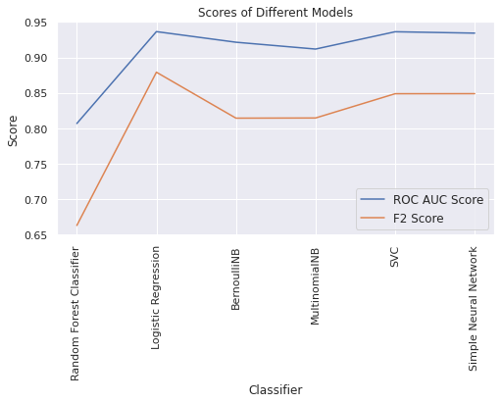
Comparing all models!
Logistic Regression is the best model!
!! No experience in deep learning
--> Overfitting
✓ Which model is the best?

Slide 36
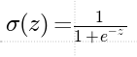
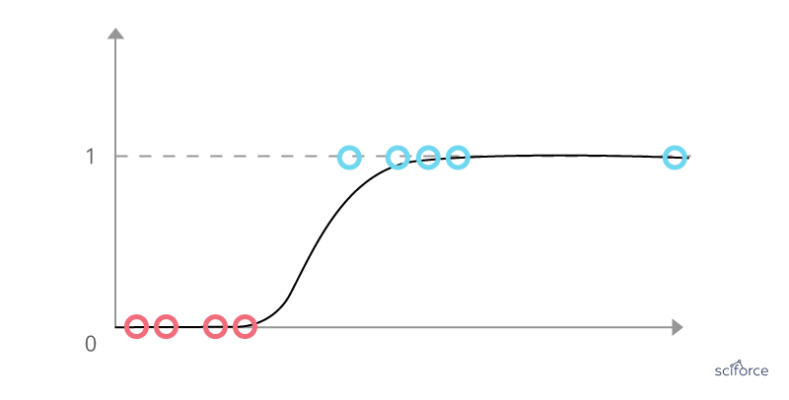
Logistic Regression
Logistic Regression can be used as a classification model
Performs linear regression first, output is z
Then passes through a sigmoid function, y = σ(z)
Distinct boundary at y = 0.5 (above is 1, below is 0)
Is a form of neural network, but scikit-learn takes care of the technical implementation

Slide 37
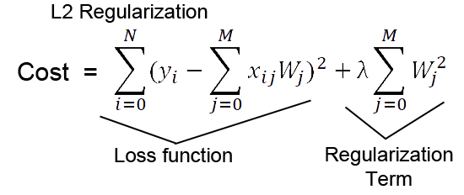
Logistic Regression (pt. 2)
Default L2 regularization is used to prevent overfitting
An additional term is added to the cost function of the model
Model will try to minimise this cost function
Parameter ‘C’ - is the inverse regularization strength

Slide 38
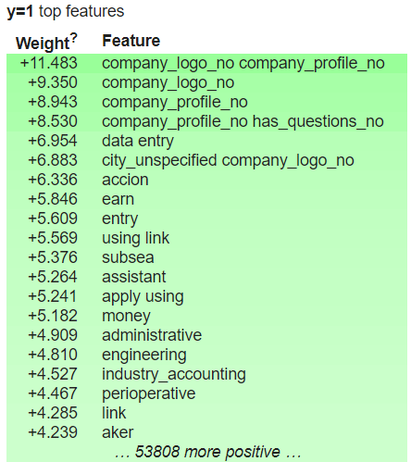
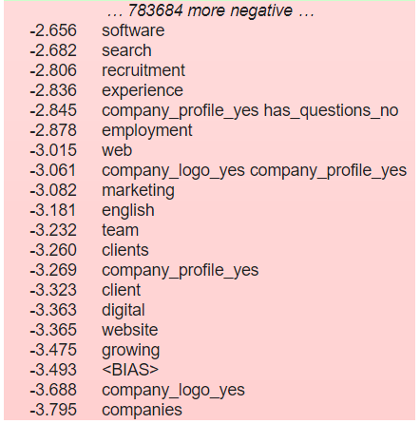
Top Features
Associated features ✓
Note: This is for all 837531 features! (not just 20000)

Slide 39
Thank you

Slide 40
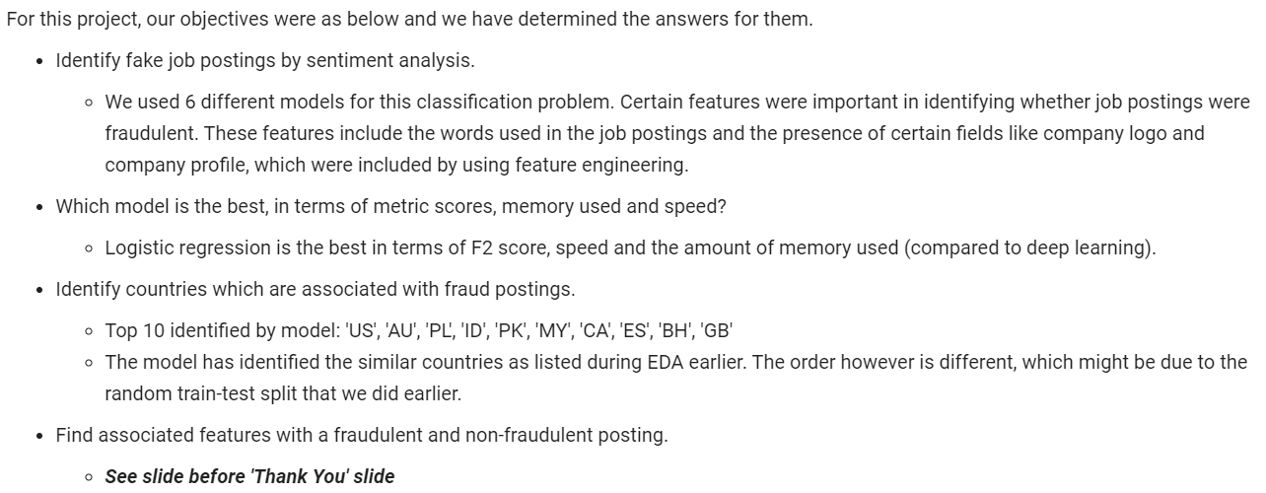
A summary of our takeaways

Slide 41
Contributions (in Alphabetical Order)
Goh Lee Hua | Text pre-processing, Random forest classifier and GridSearchCV, Markdown comments
Hansel Tay | Lemmatization, Metrics, Oversampling and undersampling techniques
Philip Lee Hann Yung | Feature extraction, TF-IDF vectorization, Modelling and Hyperparameter tuning, Organization of project pipeline, Markdown comments
Tan Keng Soon | Visualisation, Exploratory data analysis (EDA)

Slide 42
Q & A

